Slide 1
Data Structure and Algorithm
Course code: cs-201
Topic: Heaps data structure

Slide 2
Goals
Heap DS
Insertion in Heap
Deletion in Heap

Slide 3
Heap Tree Structure
In computer science, a heap is a specialized tree-based data structure that satisfies the heap property: if B is a child node of A, then key(A) ≥ key(B).
This implies that an element with the greatest key is always in the root node, and so such a heap is sometimes called a max-heap.
(Alternatively, if the comparison is reversed, the smallest element is always in the root node, which results in a min-heap.)
Node value should be greater than or equal to both children.

Slide 4
Heap Tree Structure
Heap is a complete binary tree. The binary tree is a tree in which the node can have utmost two children.
It is implemented in array as sequential representation rather than linked list.
4

Slide 5
Types of Heap Tree Structure
There are two types of the heap:
Min Heap
Max heap
5

Slide 6
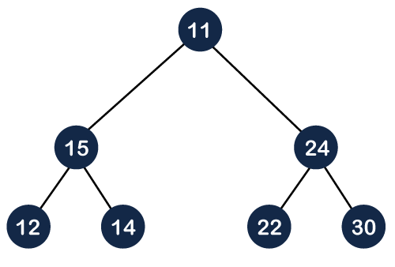
Min Heap
The value of the parent node should be less than or equal to either of its children.
Let's understand the min-heap through an example.
In the figure, 11 is the root node, and the value of the root node is less than the value of all the other nodes (left child or a right child).
6

Slide 7
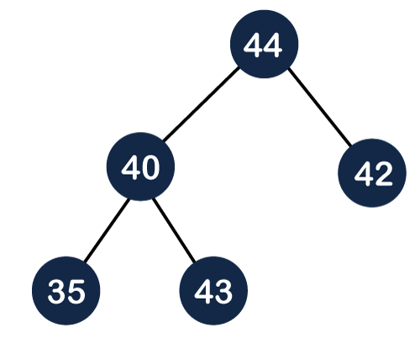
Max Heap
The value of the parent node is greater than or equal to its children.
44 is root node that is greater than both left and right child. So, it is fulfilling the max heap property.
7

Slide 8
Creation of Max Heap Tree
Suppose we want to create the max heap tree.
To create the max heap tree, we need to consider the following two cases:
First, we have to insert the element in such a way that the property of the complete binary tree must be maintained.
Secondly, the value of the parent node should be greater than the either of its child.
8

Slide 9
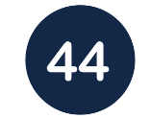
Creation of Max Heap Tree
For Example
44, 33, 77, 11, 55, 88, 66
Step 1: First we add the 44 element in the tree as shown below:
9

Slide 10
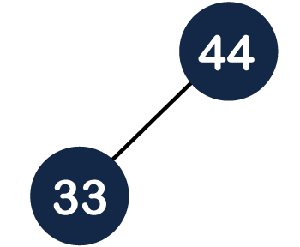
Creation of Max Heap Tree
Step 2: The next element is 33. As we know that insertion in the binary tree always starts from the left side so 33 will be added at the left of 44 as shown below:
10

Slide 11
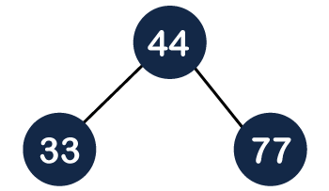
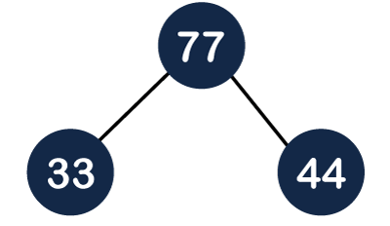
Creation of Max Heap Tree
Step 3: The next element is 77 and it will be added to the right of the 44 as shown below:
As we can observe that the tree does not satisfy the max heap property, i.e., parent node 44 is less than the R-child 77. So, we will swap these two values as shown below:
11

Slide 12
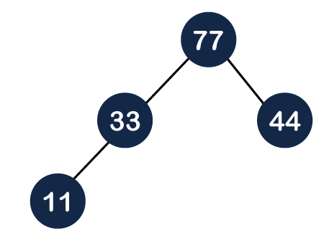
Creation of Max Heap Tree
Step 4: The next element is 11. The node 11 is added to the left of 33 as shown below:
12

Slide 13


Creation of Max Heap Tree
Step 5: The next element is 55. To make it a complete binary tree, we will add the node 55 to the right of 33 as shown below:
As we can observe that it does not satisfy the property of the max heap because 33<55, so we will swap these two values as shown below:
13

Slide 14
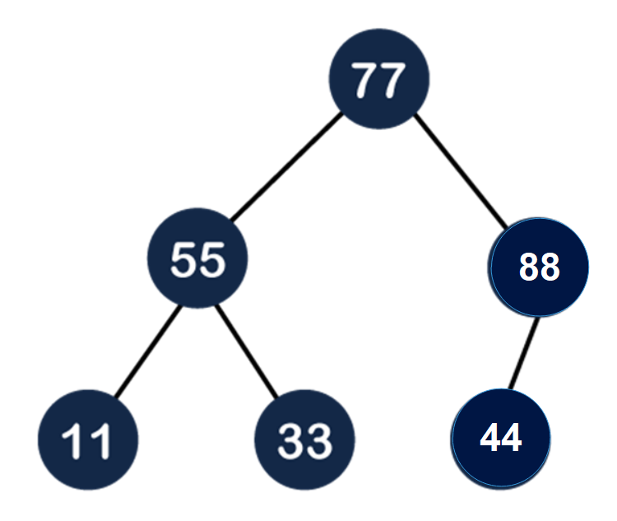
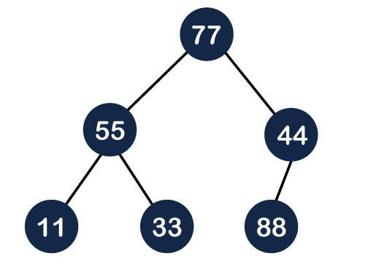
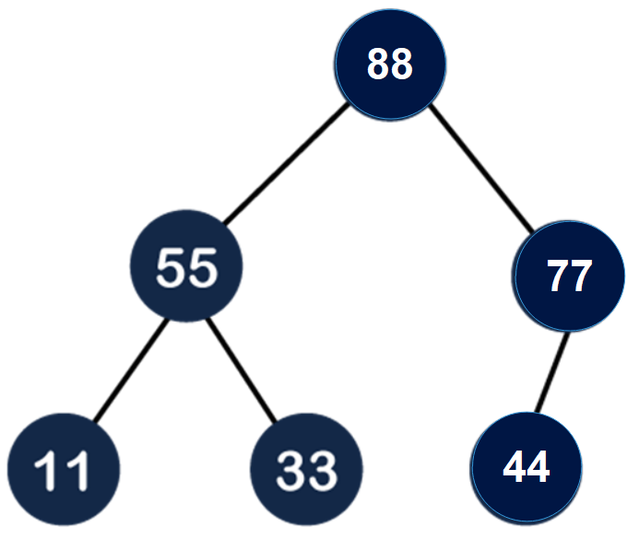
Creation of Max Heap Tree
Step 6: The next element is 88. The left subtree is completed so we will add 88 to the left of 44 as shown below:
As we can observe in the above figure that it does not satisfy the property of the max heap because 44<88, so we will swap these two values
Again, it is violating the max heap property because 88>77 so we will swap these two values.
14

Slide 15
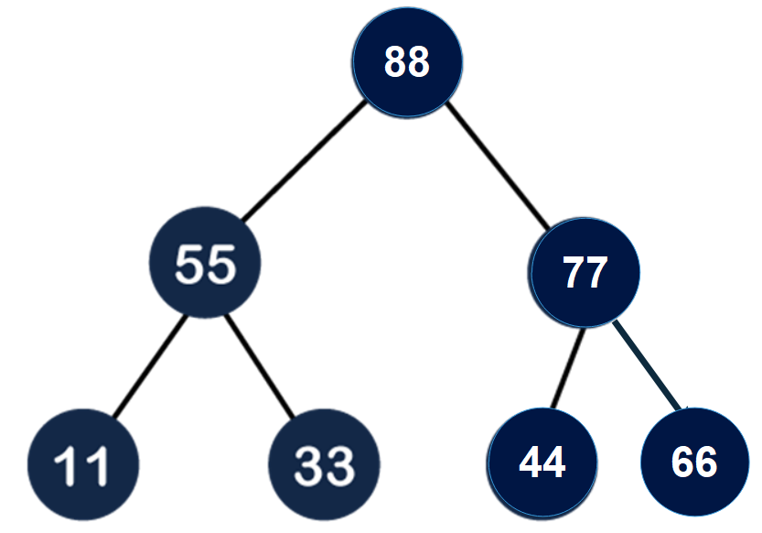
Creation of Max Heap Tree
Step 7: The next element is 66. To make a complete binary tree, we will add the 66 element to the right side of 77 as shown below:
Here, we can observe that the tree satisfies the property of max heap; therefore, it is a heap tree.
15

Slide 16
Task
Insert following data in Heap
Insert in Heap Data: 44, 30, 50, 22, 60, 55, 77
Data: 97, 88, 95, 66, 55, 95, 48, 66, 35, 48
16

Slide 17
Heap Tree Structure
Insert in Heap Data: 44, 30, 50, 22, 60, 55, 77
44
44
44
30
30
50
50
50
30
44
30
44
17
22

Slide 18
50
50
30
44
60
44
22
60
22
30
60
60
50
44
50
55
22
30
55
22
30
44

Slide 19
60
60
50
55
50
77
22
30
44
77
22
30
44
55
77
50
60
22
30
44
55

Slide 20
Insertion in Heap
To insert a node in max/ min heap following points should be considered
Cannot start insertion from root node
Insertion starts from leaf.
Follow the property of complete binary tree
Insert data as left as possible
20

Slide 21
Insertion in Heap
Suppose we want to insert 60 in the following max heap tree
70
50
40
45
35
39
16
10
9
21

Slide 22
Insertion in Heap
Fill the left most position first.
This tree satisfy the complete binary tree property but not heap property.
70
50
40
45
35
39
16
10
9
60
22

Slide 23
Insertion in Heap
Swap 60 with 35
70
50
40
45
60
39
16
10
9
35
23

Slide 24
Insertion in Heap
Now 50<60
swap
70
70
50
40
60
40
50<60
45
60
39
16
45
50
39
16
10
9
35
10
9
35
24

Slide 25
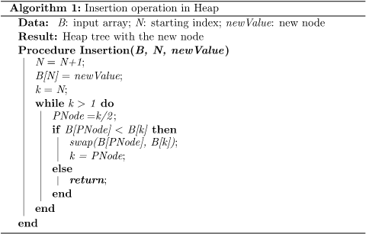
Notes:
https://www.baeldung.com/cs/heap-insertion-complexity
https://youtu.be/NEtwJASLU8Q?list=PLdo5W4Nhv31bbKJzrsKfMpo_grxuLl8LU

Slide 26
Time Complexity
The best-case scenario for insertion is when the new element does not need to be moved, which occurs in constant time, O(1).
However, in the worst-case scenario, the new element may need to be swapped up through the heap until it reaches the root. Since a heap is a complete binary tree, the height of the tree is O(log n), where n is the number of elements in the heap. Therefore, the worst-case time complexity for insertion is O(log n).
The average-case time complexity for insertion also turns out to be O(log n), considering that the new element might need to be swapped up to a level that's halfway up the heap on average.

Slide 27
Insertion in Heap
Yours Turn!
Insert 72
70
60
40
45
50
39
16
10
9
35
27

Slide 28
Deletion in Heap
In case of deletion, always root element is deleted first and it is replaced by last element. Besides condition of heap is maintained.
50
40
50
20
22
35
45
28

Slide 29
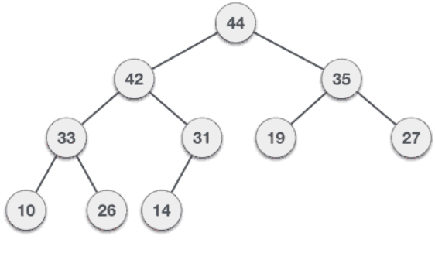
Deletion in Heap
To delete 44 in max heap tree
29

Slide 30
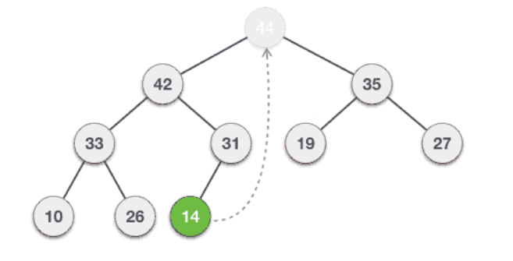
Deletion in Heap
Swap it with the last element
30

Slide 31
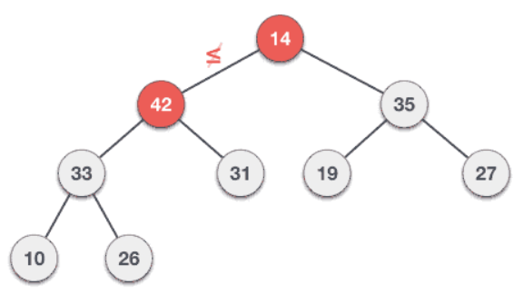
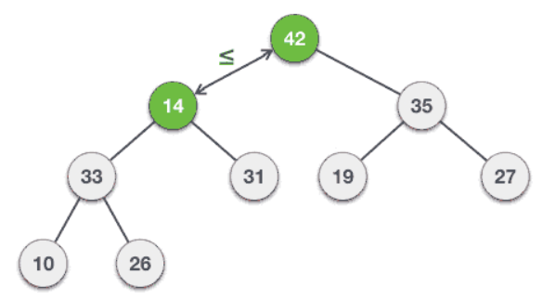
Deletion in Heap
31

Slide 32
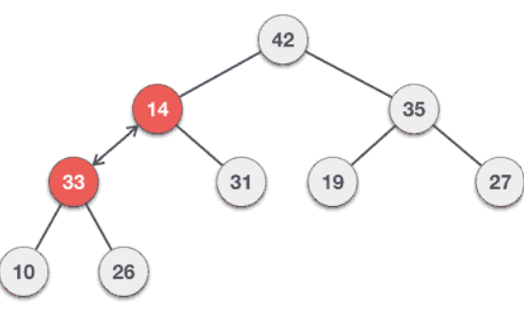
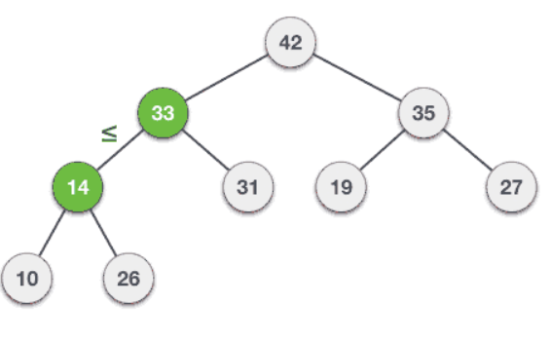
Deletion in Heap
32

Slide 33
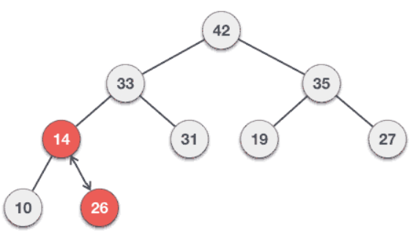
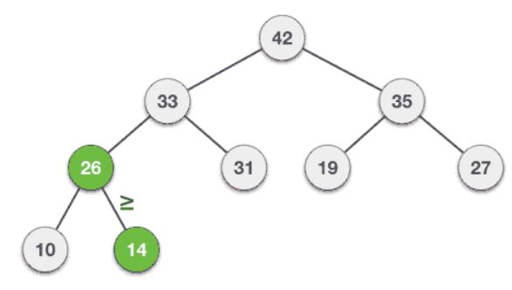
Deletion in Heap
33

Slide 34
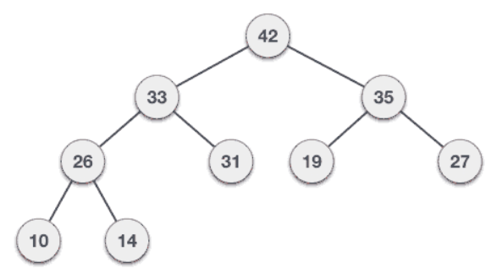
Deletion in Heap
34

Slide 35
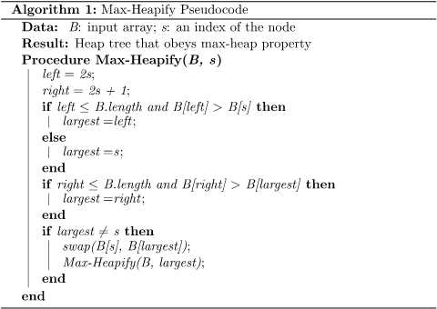
Notes:
https://www.baeldung.com/cs/binary-tree-max-heapify
https://www.geeksforgeeks.org/insertion-and-deletion-in-heaps/

Slide 36
Time Complexity
The best-case scenario for deletion is when the last element that replaces the root is already in the correct position, requiring no further action. This also occurs in constant time, O(1). The worst-case scenario for deletion, similar to insertion, involves heapifying the new root down to the lowest level of the heap, which has a time complexity of O(log n).
The average-case time complexity for deletion is also O(log n), as the new root might need to be swapped down to a level that's halfway down the heap on average.

Slide 37
45
50
40
50
40
45
20
22
35
20
22
35
35
45
40
45
40
35
20
22
20
22

Slide 38
22
40
40
35
22
35
20
20
20
35
20
22
35
22
20
22
22
20
20

